Slide 1
Hexadecimal numbers
by Adham Hany

Slide 2
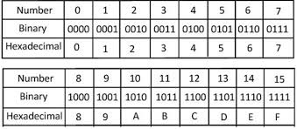
What is Hexadecimal ?
Hexadecimal numbers are a base-16 number system, which means they use 16 unique symbols to represent values. These symbols are the digits 0-9 and the letters A-F, where A represents 10, B represents 11, and so on, up to F which represents 15.

Slide 3
What is the use of Hexadecimal?
Shorthand for Binary
Memory Addressing
All because it is more optimized way to represent Data
Color Codes
MAC Addresses

Slide 4
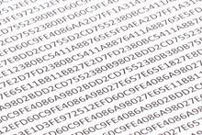
Can we use Hexadecimals in our daily life?
Yes we can, you can encrypt with it your secrets , or make it as your password with a hidden massage, all of this comes to your imagination.

Slide 5

Sources of information
Gemini
www.google.com
Thanks for your time.
By Adham Hany

